Slide 1
How to use an audience response system (ARS)
Customizable Instruction Slides
(feel free to customize, replace, modify or completely remove elements from these slides to best match your event’s workflow and requirements)

Slide 2
Introduction
This meeting will be interactive - you will be asked to respond to questions throughout the presentation
Do so by using a wireless keypad that you’ve been given
Please don’t take the keypad with you – it doesn’t work outside of this room and has a high replacement cost
Return the keypads to the registration desk, or designated collection area when you’re done using it

Slide 3
Using the Keypads
To respond, simply press the button on the keypad that matches your desired answer
You may respond whenever the question is displayed, even before the countdown starts

Slide 4
Meridia Tips & Tricks
Make sure that everyone understands when and how to vote
You may want to start out with a ‘warmup’ question, or two. Trivia, or a funny question will break the ice with the audience and let them familiarize themselves with the system
It will also serve as a ‘check-in’ or ‘roll-call’ and establish the fact that the system IS WORKING CORRECTLY and increase trust in the electronic voting
Depending on your event/questions, explaining how a single-vote vs. multi-vote questions work will ensure correct and timely answers
It’s best to announce or remind the audience of a change of voting method/style by creating a ‘holding slide’ before going from single-vote to multi-vote slides

Slide 5
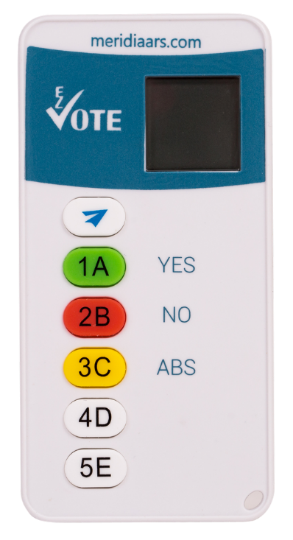
Using the Keypad Single-Vote Slides
To respond, simply press the button on the keypad that matches your desired answer
Your vote will be submitted/sent automatically
“OK” will appear on your keypad display, confirming receipt of the vote
You may respond whenever the question is displayed, even before the countdown starts
You may correct your previous votes as long as the polling is open. Only your last vote counts

Slide 6
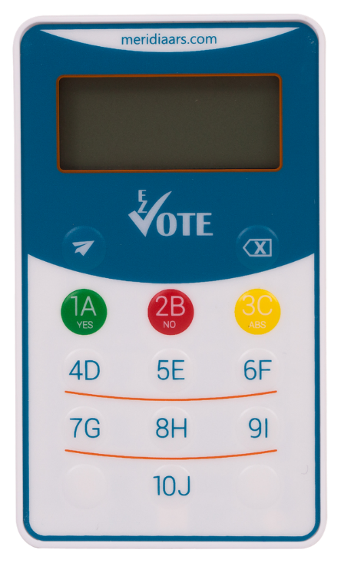
Using the Keypad Multi-Vote Slides
Press the button(s) that match your desired answers in the sequence you want them to be submitted in
To correct your answers, press the Clear/Backspace button (top-right)
Once your final answers are on the screen, press “Send” (paper plane)
“OK” will appear on your keypad display, confirming receipt of the vote(s)
EZ-VOTE HD shows a lowercase “o” instead

Slide 7
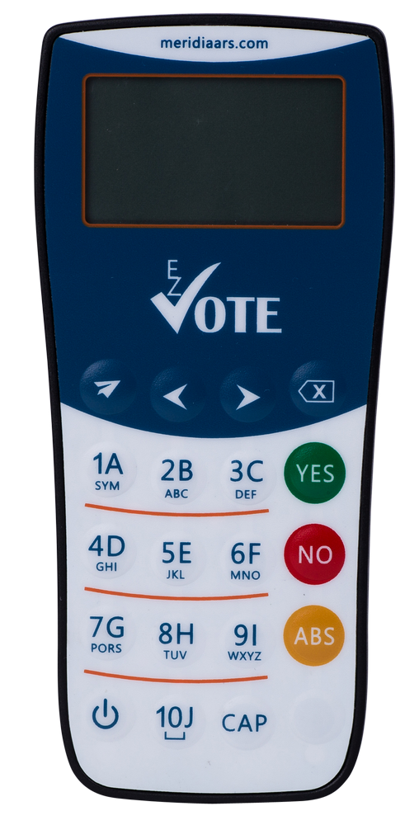
Other Keypad Images

Slide 8
Using the Rental/Lease Keypad Single-Vote Slides
To respond, simply press the button on the keypad that matches your desired answer
Your vote will be submitted/sent automatically
When you see the number disappear from the keypad, your vote has been counted
You may respond whenever the question is displayed, even before the countdown starts
You may correct your previous votes as long as the polling is open. Only your last vote counts

Slide 9
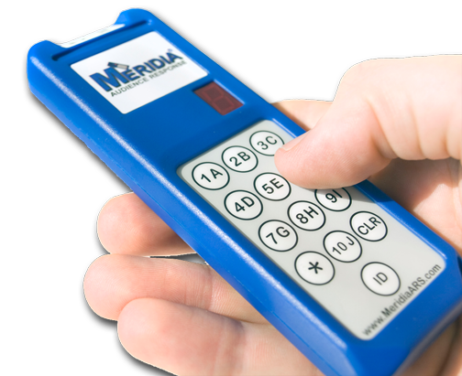
Using the Rental/Lease Keypad Multi-Vote Slides
Press the button(s) that match your desired answers, one at a time
Give the keypad some time to process the last vote before you vote again
In other words, wait for the first number to disappear (register) before you push the second number
Like with the single-vote slide, when the number disappears, your vote has been counted

Slide 10
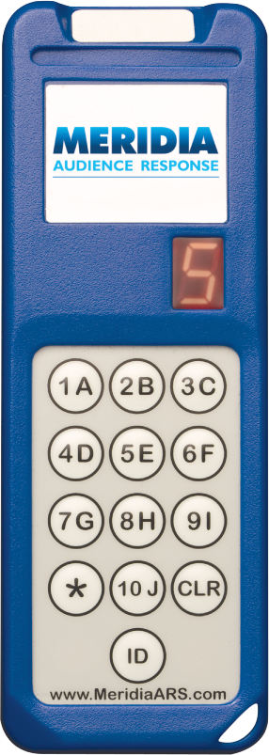
Other Keypad Images

